Slide 1
Introduce Zephyr
Chun-Chieh Li

Slide 2
Overview
Introduction
Install development environment
Kernel configuration system (Kconfig)
Devicetree

Slide 3
Introduction
RTOS, targeting resource-constrained and embedded system
License
Apache 2.0 license (zephyr/LICENSE)
Some other Zephyr projects
https://docs.zephyrproject.org/latest/LICENSING.html#zephyr-licensing
Support architecture
ARMv6-M, ARMv7-M, and ARMv8-M (Cortex-M)
Support language
C/C++
Support toolchain
Cross GCC

Slide 4
Introduction
Support development environment
CLI
https://docs.zephyrproject.org/latest/develop/getting_started/index.html
VS Code
https://marketplace.visualstudio.com/items?itemName=Nuvoton.nuvoton-numicro-cortex-m-pack

Slide 5
Our ports: Support boards
zephyr/boards/nuvoton/
|-- index.rst
|-- npck3m8k_evb
|-- npcm400_evb
|-- npcx4m8f_evb
|-- npcx7m6fb_evb
|-- npcx9m6f_evb
|-- numaker_gai_m55m1
|-- numaker_m2l31ki
|-- numaker_m3334ki
|-- numaker_m5531
|-- numaker_m55m1
|-- numaker_pfm_m467
`-- numaker_pfm_m487

Slide 6
Our ports: Support peripherals (1/2)
zephyr/drivers/adc/adc_numaker.c
zephyr/drivers/can/can_numaker.c
zephyr/drivers/clock_control/clock_control_numaker_scc.c
zephyr/drivers/ethernet/eth_numaker.c
zephyr/drivers/flash/soc_flash_numaker.c
zephyr/drivers/flash/soc_flash_numaker_rmc.c
zephyr/drivers/gpio/gpio_numaker.c
zephyr/drivers/hwinfo/hwinfo_numaker.c
zephyr/drivers/hwinfo/hwinfo_numaker_rmc.c
zephyr/drivers/i2c/i2c_numaker.c
zephyr/drivers/misc/ethos_u/ethos_u_numaker.c
zephyr/drivers/pinctrl/pinctrl_numaker.c

Slide 7
Our ports: Support peripherals (2/2)
zephyr/drivers/pwm/pwm_numaker.c
zephyr/drivers/reset/reset_numaker.c
zephyr/drivers/rtc/rtc_numaker.c
zephyr/drivers/serial/uart_numaker.c
zephyr/drivers/spi/spi_numaker.c
zephyr/drivers/usb/device/usb_dc_numaker.c
zephyr/drivers/usb/udc/udc_numaker.c
zephyr/drivers/usb_c/ppc/usbc_ppc_numaker.c
zephyr/drivers/usb_c/tcpc/ucpd_numaker.c
zephyr/drivers/usb_c/vbus/usbc_vbus_numaker.c
zephyr/drivers/watchdog/wdt_wwdt_numaker.c

Slide 8
Install development environment
Python (3.10)
Add into PATH
Git
Add into PATH
Git Bash as CLI
CMake (3.20.5) & Ninja
Add into PATH
Python virtual environment
$ mkdir zephyrproject
$ python -m venv zephyrproject/.venv
$ source zephyrproject/.venv/Scripts/activate

Slide 9
Install development environment
West
$ pip install --upgrade west
Example code
$ unzip -d zephyrproject EC_M55M1_Zephyr_ML_KWS_V1.00.zip
$ mv zephyrproject/EC_M55M1_Zephyr_ML_KWS_V1.00 zephyrproject/EC_M55M1_Zephyr_ML_KWS
West workspace ‘zephyrproject’
Manifest repository: EC_M55M1_Zephyr_ML_KWS/west.yml vs. zephyr/west.yml
$ cd zephyrproject
$ west init --local EC_M55M1_Zephyr_ML_KWS

Slide 10
Install development environment
Pull in external dependencies (EC_M55M1_Zephyr_ML_KWS/west.yml)
$ west update
zephyrproject/
|-- EC_M55M1_Zephyr_ML_KWS
|-- modules
|-- optional
`-- zephyr
zephyrproject/modules/
|-- hal
| |-- cmsis_6
| |-- ethos_u
| `-- nuvoton
`-- lib
|-- cmsis-dsp
`-- cmsis-nn
zephyrproject/optional/
`-- modules
`-- lib
`-- tflite-micro

Slide 11
Install development environment
Pull in external dependencies (zephyr/west.yml)
$ west update
zephyrproject/modules/
|-- bsim_hw_models
| `-- nrf_hw_models
|-- crypto
| |-- mbedtls
| `-- tinycrypt
|-- debug
| |-- mipi-sys-t
| |-- percepio
| `-- segger
|-- fs
| |-- fatfs
| `-- littlefs
|-- hal
| |-- adi
| |-- afbr
| |-- altera
| |-- ambiq
| |-- atmel
| |-- bouffalolab
| |-- cmsis
| |-- cmsis_6
| |-- espressif
| |-- ethos_u
| |-- gigadevice
| |-- infineon
| |-- intel
| |-- libmetal
| |-- microchip

Slide 12
Install development environment
Python dependencies, including pyOCD
$ west packages pip –install
Zephyr SDK toolchain
arm-zephyr-eabi vs. arm-none-eabi
$ west sdk install --install-base toolchains --toolchains arm-zephyr-eabi --no-hosttools
Support pyOCD flash for M55M1
Download Nuvoton.NuMicroM55_DFP.x.y.z.pack
Create zephyrproject/pyocd.yaml
pack:
- C:\Users\<USER>\Downloads\Nuvoton.NuMicroM55_DFP.<x.y.z>.pack

Slide 13
Install development environment
Vela compiler
$ pip install --upgrade ethos-u-vela
Leave Python virtual environment
$ deactivate

Slide 14
Build example code
Enter Python virtual environment
$ source zephyrproject/.venv/Scripts/activate
Enter West workspace ‘zephyrproject’
$ cd zephyrproject
Compile
$ west -v build -b numaker_m55m1 EC_M55M1_Zephyr_ML_KWS/SampleCode/ExampleCode/Zephyr_ML_KWS
Flash
$ west flash
Leave Python virtual environment
$ deactivate

Slide 15
Kernal configuration system (Kconfig) (1/2)
Software configuration
Allow to enable, disable, and parameterize software components, drivers, and OS features
Define Kconfig symbols (Kconfig* files). Its tree:
<PROJECT>/Kconfig
zephyr/Kconfig.zephyr
zephyr/boards/<VENDOR>/<BOARD>/Kconfig*
Change Kconfig symbol values (Kconfig fragments). Its include tree:
Board/SoC default (*_defconfig)
zephyr/boards/<VENDOR>/<BOARD>/<BOARD>_defconfig
CMake cache variables 'CONFIG_*’
Application specific
<PROJECT>/prj.conf
<PROJECT>/boards/<BOARD>.conf

Slide 16
Kernal configuration system (Kconfig) (2/2)
Generated combined configuration file
<BUILD>/zephyr/.config
Generated C header file
<BUILD>/zephyr/include/generated/zephyr/autoconf.h
Auto-included via ‘-imacros autoconf.h’
Kconfig search
https://docs.zephyrproject.org/latest/kconfig.html

Slide 17
Common Kconfig options (1/3)
Cache
CONFIG_CACHE_MANAGEMENT
FPU
CONFIG_FPU
CONFIG_FPU_SHARING
CONFIG_FP_HARDABI
Compiler optimization level
CONFIG_SIZE_OPTIMIZATIONS (-Os) (default)
CONFIG_SIZE_OPTIMIZATIONS_AGGRESSIVE (-Oz)
CONFIG_SPEED_OPTIMIZATIONS (-O2)
CONFIG_DEBUG_OPTIMIZATIONS (-Og)
CONFIG_NO_OPTIMIZATIONS (-O0) (stack overflow)

Slide 18
Common Kconfig options (2/3)
Main stack
CONFIG_MAIN_STACK_SIZE
Logging
CONFIG_LOG
CONFIG_REQUIRES_FLOAT_PRINTF (floating-point)
CONFIG_LOG_BLOCK_IN_THREAD (few messages dropped)
C++ language
CONFIG_CPP
CONFIG_STD_CPP17

Slide 19
Common Kconfig options (3/3)
CMSIS DSP
CONFIG_CMSIS_DSP
CONFIG_CMSIS_DSP_COMPLEXMATH, CONFIG_CMSIS_DSP_FASTMATH, CONFIG_CMSIS_DSP_TRANSFORM, etc.

Slide 20
Devicetree (1/4)
A hierarchical data structure used to describe hardware and its boot-time configuration
Unlike Linux, Zephyr parses the DTS at compile time and generates C language macros, rather than blob.
Constituent files
DTS: *.dts files for board-level configuration
DTSI: *.dtsi (include) files usually for SoC-level definitions
Bindings (YAML): *.yaml files for defining which properties are valid within a node and linking H/W to driver files
Overlays (.overlay): *.overlay files for allowing customizing or overriding H/W configurations

Slide 21
Devicetree (2/4)
Its include tree:
Board DTS file (--board)
zephyr/boards/<VENDOR>/<BOARD>/<BOARD>.dts
Included SoC-level DTSI file (#include)
Zephyr/dts/arm/nuvoton/<SOC>.dtsi
Included C header file (#include)
*.h
Board overlay file
<PROJECT>/boards/<BOARD>.overlay
<PROJECT>/app.overlay

Slide 22
Devicetree (3/4)
Generated combined DTS file
<BUILD>/zephyr/zephyr.dts
Generated C macro header file
build/zephyr/include/generated/zephyr/devicetree_generated.h
Example: DT_N_S_soc_S_serial_4024d000_P_current_speed
DT_: Common prefix for Devicetree macros
_S_ : Forward slash ‘/’
_N_ : Node
_P_: Property

Slide 23
Devicetree (4/4)
Devicetree API
https://docs.zephyrproject.org/latest/build/dts/api/api.html

Slide 24
Devicetree: System Clock Controller (1/3)
zephyr/dts/arm/nuvoton/m55m1x.dtsi
scc: system-clock-controller@40001000 {
compatible = "nuvoton,numaker-scc";
reg = <0x40001000 0x100>;
#clock-cells = <0>;
lxt = "enable";
hirc48m = "enable";
clk-pclkdiv = <(NUMAKER_CLK_PCLKDIV_PCLK0DIV(2) |
NUMAKER_CLK_PCLKDIV_PCLK1DIV(2) |
NUMAKER_CLK_PCLKDIV_PCLK2DIV(2) |
NUMAKER_CLK_PCLKDIV_PCLK3DIV(2) |
NUMAKER_CLK_PCLKDIV_PCLK4DIV(2))>;
core-clock = <DT_FREQ_M(220)>;
powerdown-mode = <NUMAKER_PMC_SPD0>;

Slide 25
Devicetree: System Clock Controller (2/3)
zephyr/dts/bindings/clock/nuvoton,numaker-scc.yaml
description: Nuvoton NuMaker System Clock Controller (SCC)
compatible: "nuvoton,numaker-scc"
include: [clock-controller.yaml, base.yaml]
properties:
reg:
required: true
hxt:
type: string
lxt:
type: string

Slide 26
Devicetree: System Clock Controller (3/3)
zephyr/soc/nuvoton/numaker/m55m1x/soc.c
#if DT_NODE_HAS_PROP(DT_NODELABEL(scc), clk_pclkdiv)
/* Set CLK_PCLKDIV register on request */
CLK->PCLKDIV = DT_PROP(DT_NODELABEL(scc), clk_pclkdiv);
#endif
#if DT_NODE_HAS_PROP(DT_NODELABEL(scc), core_clock)
/* Set core clock (HCLK) on request */
CLK_SetCoreClock(DT_PROP(DT_NODELABEL(scc), core_clock));
#endif

Slide 27
Devicetree: Peripheral Clock Controller (1/4)
CLK_EnableModuleClock
CLK_SetModuleClock
zephyr/dts/arm/nuvoton/m55m1x.dtsi
uart0: serial@4024d000 {
compatible = "nuvoton,numaker-uart";
reg = <0x4024d000 0x1000>;
interrupts = <75 0>;
resets = <&rst NUMAKER_SYS_UART0RST>;
clocks = <&pcc
NUMAKER_UART0_MODULE
NUMAKER_CLK_UARTSEL0_UART0SEL_HIRC
NUMAKER_CLK_UARTDIV0_UART0DIV(1)>;
};
zephyr/dts/arm/nuvoton/m55m1x.dtsi
scc: system-clock-controller@40001000 {
pcc: peripheral-clock-controller {
compatible = "nuvoton,numaker-pcc";
#clock-cells = <3>;
};

Slide 28
Devicetree: Peripheral Clock Controller (2/4)
zephyr/dts/bindings/clock/nuvoton,numaker-pcc.yaml
description: Nuvoton NuMaker Peripheral Clock Controller (PCC)
compatible: "nuvoton,numaker-pcc"
include: [clock-controller.yaml, base.yaml]
properties:
"#clock-cells":
const: 3
clock-cells:
- clock-module-index
- clock-source
- clock-divider

Slide 29
Devicetree: Peripheral Clock Controller (3/4)
zephyr/drivers/clock_control/clock_control_numaker_scc.c
static inline int numaker_scc_configure(const struct device *dev, clock_control_subsys_t subsys,
void *data)
{
struct numaker_scc_subsys *scc_subsys = (struct numaker_scc_subsys *)subsys;
if (scc_subsys->subsys_id == NUMAKER_SCC_SUBSYS_ID_PCC) {
SYS_UnlockReg();
CLK_SetModuleClock(scc_subsys->pcc.clk_modidx, scc_subsys->pcc.clk_src,
scc_subsys->pcc.clk_div);
SYS_LockReg();
} else {

Slide 30
Devicetree: Peripheral Clock Controller (4/4)
zephyr/drivers/serial/uart_numaker.c
Devicetree API
.clk_modidx = DT_INST_CLOCKS_CELL(inst, clock_module_index),
.clk_src = DT_INST_CLOCKS_CELL(inst, clock_source),
.clk_div = DT_INST_CLOCKS_CELL(inst, clock_divider),
Clock Controller API
scc_subsys.pcc.clk_modidx = config->clk_modidx;
scc_subsys.pcc.clk_src = config->clk_src;
scc_subsys.pcc.clk_div = config->clk_div;
clock_control_on(config->clk_dev, (clock_control_subsys_t)&scc_subsys);
clock_control_configure(config->clk_dev, (clock_control_subsys_t)&scc_subsys, NULL);

Slide 31
Devicetree: Reset Controller (1/4)
SYS_ResetModule
zephyr/dts/arm/nuvoton/m55m1x.dtsi
uart0: serial@4024d000 {
compatible = "nuvoton,numaker-uart";
reg = <0x4024d000 0x1000>;
interrupts = <75 0>;
resets = <&rst NUMAKER_SYS_UART0RST>;
clocks = <&pcc
NUMAKER_UART0_MODULE
NUMAKER_CLK_UARTSEL0_UART0SEL_HIRC
NUMAKER_CLK_UARTDIV0_UART0DIV(1)>;
};
zephyr/dts/arm/nuvoton/m55m1x.dtsi
rst: reset-controller@40000000 {
compatible = "nuvoton,numaker-rst";
reg = <0x40000000 0x2e0>;
#reset-cells = <1>;
};

Slide 32
Devicetree: Reset Controller (2/4)
zephyr/dts/bindings/reset/nuvoton,numaker-rst.yaml
description: Nuvoton, Numaker-RESET
compatible: "nuvoton,numaker-rst"
include: [reset-controller.yaml, base.yaml]
properties:
reg:
required: true
"#reset-cells":
const: 1
reset-cells:
- id

Slide 33
Devicetree: Reset Controller (3/4)
zephyr/drivers/reset/reset_numaker.c
static DEVICE_API(reset, reset_numaker_driver_api) = {
.status = reset_numaker_status,
.line_assert = reset_numaker_line_assert,
.line_deassert = reset_numaker_line_deassert,
.line_toggle = reset_numaker_line_toggle,
};
static const struct reset_numaker_config config = {
.base = (uint32_t)DT_INST_REG_ADDR(0),
};
DEVICE_DT_INST_DEFINE(0, NULL, NULL, NULL, &config, PRE_KERNEL_1,
CONFIG_RESET_INIT_PRIORITY, &reset_numaker_driver_api);

Slide 34
Devicetree: Reset Controller (4/4)
zephyr/include/zephyr/drivers/reset.h
reset_status
reset_line_assert
reset_line_deassert
reset_line_toggle

Slide 35
Devicetree: Pin Controller (1/7)
Pin multi-function (SYS) + partial pin configurations (GPIO)
zephyr/boards/nuvoton/numaker_m55m1/numaker_m55m1.dts
&emac {
pinctrl-0 = <&emac_default>;
pinctrl-names = "default";
status = "okay";
};
zephyr/dts/arm/nuvoton/m55m1x.dtsi
pinctrl: pin-controller@40000080 {
compatible = "nuvoton,numaker-pinctrl";
reg = <0x40000080 0x30 0x40000300 0x100>;
reg-names = "mfos", "mfp";
};

Slide 36
Devicetree: Pin Controller (2/7)
group1 {
pinmux = <PE10MFP_EMAC0_RMII_TXD0>,
<PE11MFP_EMAC0_RMII_TXD1>,
<PE12MFP_EMAC0_RMII_TXEN>;
slew-rate = "fast";
};
};
zephyr/boards/nuvoton/numaker_m55m1/numaker_m55m1-pinctrl.dtsi
emac_default: emac_default {
group0 {
pinmux = <PE8MFP_EMAC0_RMII_MDC>,
<PE9MFP_EMAC0_RMII_MDIO>,
<PC8MFP_EMAC0_RMII_REFCLK>,
<PC7MFP_EMAC0_RMII_RXD0>,
<PC6MFP_EMAC0_RMII_RXD1>,
<PA7MFP_EMAC0_RMII_CRSDV>,
<PA6MFP_EMAC0_RMII_RXERR>;
};

Slide 37
Devicetree: Pin Controller (3/7)
zephyr/dts/bindings/pinctrl/nuvoton,numaker-pinctrl.yaml
compatible: "nuvoton,numaker-pinctrl"
include: base.yaml
properties:
reg:
required: true
child-binding:
child-binding:
include:
- name: pincfg-node.yaml
property-allowlist:
- drive-open-drain
- input-schmitt-enable

Slide 38
Devicetree: Pin Controller (4/7)
zephyr/dts/bindings/pinctrl/nuvoton,numaker-pinctrl.yaml
child-binding:
child-binding:
properties:
pinmux:
required: true
type: array
drive-strength:
type: string
default: "low"
enum:
- "low"
- "fast"

Slide 39
Devicetree: Pin Controller (5/7)
zephyr/dts/bindings/pinctrl/nuvoton,numaker-pinctrl.yaml
child-binding:
child-binding:
properties:
slew-rate:
type: string
default: "low"
enum:
- "low"
- "high"
- "fast"
digital-path-disable:
type: boolean

Slide 40
Devicetree: Pin Controller (6/7)
zephyr/drivers/pinctrl/pinctrl_numaker.c
Devicetree API
#define MFP_BASE DT_INST_REG_ADDR_BY_NAME(0, mfp)
#define MFOS_BASE DT_INST_REG_ADDR_BY_NAME(0, mfos)
#define GPA_BASE DT_REG_ADDR(DT_NODELABEL(gpioa))
#define GPIO_SIZE DT_REG_SIZE(DT_NODELABEL(gpioa))
Pin Controller Driver API
int pinctrl_configure_pins(const pinctrl_soc_pin_t *pins, uint8_t pin_cnt, uintptr_t reg)
{
/* Configure all peripheral devices' properties here. */
for (uint8_t i = 0U; i < pin_cnt; i++) {
configure_pin(&pins[i]);
}
return 0;
}

Slide 41
Devicetree: Pin Controller (7/7)
zephyr/drivers/serial/uart_numaker.c
Devicetree API
#define PINCTRL_DEFINE(n) PINCTRL_DT_INST_DEFINE(n);
#define PINCTRL_INIT(n) .pincfg = PINCTRL_DT_INST_DEV_CONFIG_GET(n),
Pin Controller API
err = pinctrl_apply_state(config->pincfg, PINCTRL_STATE_DEFAULT);

Slide 42
Devicetree: GPIO (1/3)
zephyr/samples/subsys/usb_c/sink/boards/numaker_m2l31ki.overlay
&tcpc0 {
gpios = <&gpioa 12 0>, <&gpioa 1 GPIO_ACTIVE_HIGH>;
gpio-names = "vbus-detect", "vbus-discharge";
};
&gpioa {
status = "okay";
};
zephyr/dts/arm/nuvoton/m2l31x.dtsi
gpioa: gpio@40004000 {
compatible = "nuvoton,numaker-gpio";
gpio-controller;
#gpio-cells = <2>;
reg = <0x40004000 0x40>;
clocks = <&pcc NUMAKER_GPA_MODULE 0 0>;
status = "disabled";
interrupts = <16 2>;
};

Slide 43
Devicetree: GPIO (2/3)
zephyr/dts/bindings/gpio/nuvoton,numaker-gpio.yaml
compatible: "nuvoton,numaker-gpio"
include: [gpio-controller.yaml, base.yaml]
properties:
reg:
required: true
"#gpio-cells":
const: 2
gpio-cells:
- pin
- flags

Slide 44
Devicetree: GPIO (3/3)
zephyr/drivers/usb_c/tcpc/ucpd_numaker.c
Devicetree API
.port = DEVICE_DT_GET(DT_PHANDLE_BY_NAME(node_id, gpios, vbus_detect))
.pin = DT_PHA_BY_NAME(node_id, gpios, vbus_detect, pin)
.dt_flags = DT_PHA_BY_NAME(node_id, gpios, vbus_detect, flags)
GPIO API
gpio_is_ready_dt
gpio_pin_*

Slide 46
合法 icon set (有新需求請與MM申請)
icon 可以變顏色喔！
作法：圖形格式→圖案填滿

Slide 47
合法 Icon Set
icon 可以變顏色喔！
作法：圖形格式→圖案填滿

Slide 48
合法 Icon Set
icon 可以變顏色喔！
作法：圖形格式→圖案填滿

Slide 49
合法 Icon Set
icon 可以變顏色喔！
作法：圖形格式→圖案填滿

Slide 50
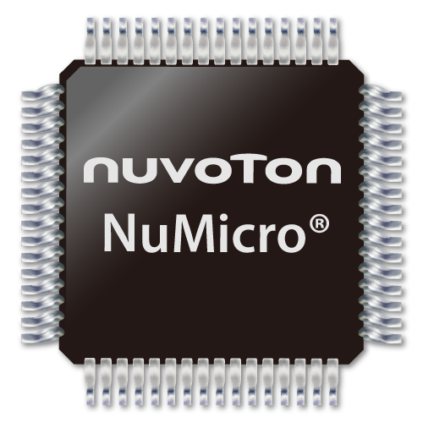
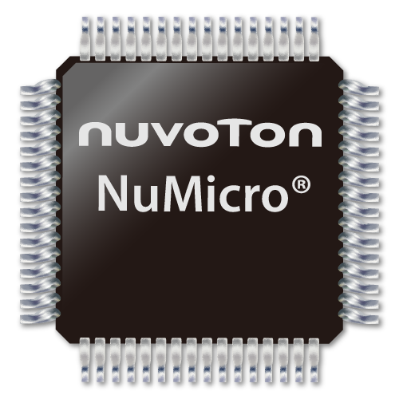
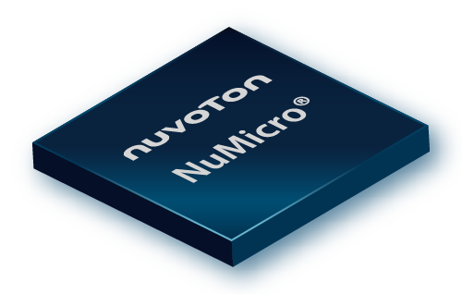
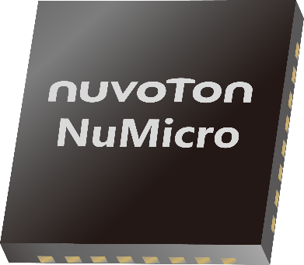
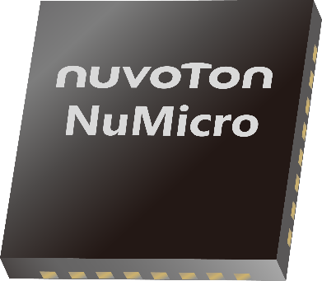
微控制器示意圖
NUC980
↑ 可更改型號 ↑
NUC980
可用來做應用方塊圖唷！
↑ 可更改型號 ↑
50

Slide 51
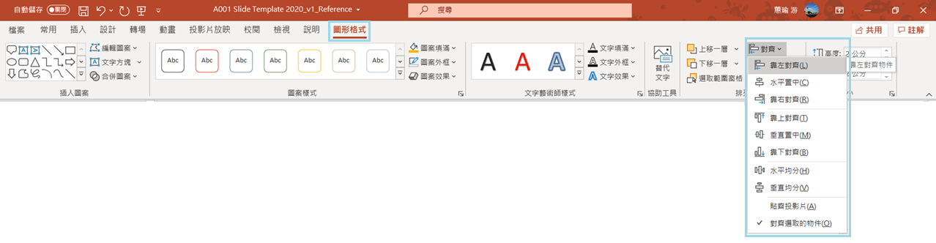
投影片製作常用小技巧 (1) 對齊
原狀
水平置中
垂直均分
步驟
將要對齊的物件們都選起來
點選「圖形格式」
點選「對齊」
適用於Roadmap、Block Diagram 等，只要有一堆東西需要對齊就很好用。

Slide 52
投影片製作常用小技巧 (2) SmartArt
SmartArt設計
版面配置
輸入文字 先打字 再選排版 也可以啦
變更色彩
SmartArt樣式
取消群組！
內建的SmartArt對於表達一些有層次的資訊非常好用，預設的色彩配置與效果也有在進步，是滿實用的工具。
但也由於這個預定義，有時候要調整細節很不容易。
比如說不過想加幾個字，整組SmartArt突然字變超小，明明旁邊空白還很多；或是動了其中一個圖框，整組圖框集體暴走，面目全非 (誇張)。
但其實SmartArt沒那麼難控制，它的原理是群組在一起的色塊與文字欄位。
只要在SmartArt物件上按右鍵，展開「組成群組」選單，點選「取消群組」，就可以還原這些色塊與文字欄位，就原本的操作習慣進行調整囉！

Slide 53

Search the image library: Adobe Stock
Enter Adobe Stock
Find the required images. And then provide the image link or file number for MM to assist with the download.
Link
File number

